Slide 1
The Vietnam War

Slide 2
Review….
Ho chi minh vs. japan
Ho chi minh and Vietminh vs. france….dien bien phu
Geneva Accords: 17th parallel, elections, diem in charge of south
Diem: Catholic and anti-communist
Domino theory

Slide 3
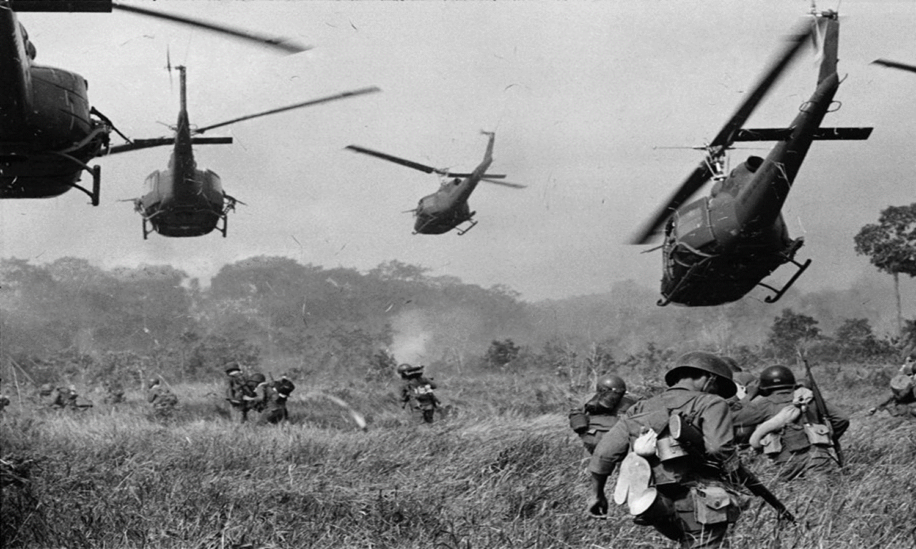
American involvement deepens
After diem refused elections, ho began an armed struggle to reunify the nation. Organized a guerilla army in the south, became known as the Vietcong.
Diem looked to the us for more support and aid to keep the south from collapsing to communism

Slide 4
Kennedy takes over
From 1961 to 63, the number of American military personnel in south Vietnam jumped from about 2,000 to around 15,000
Strategic hamlets: special fortified villages protected by machine guns, bunkers, trenches, and barbed wire
Peasants were uprooted and this program was extremely unpopular

Slide 5
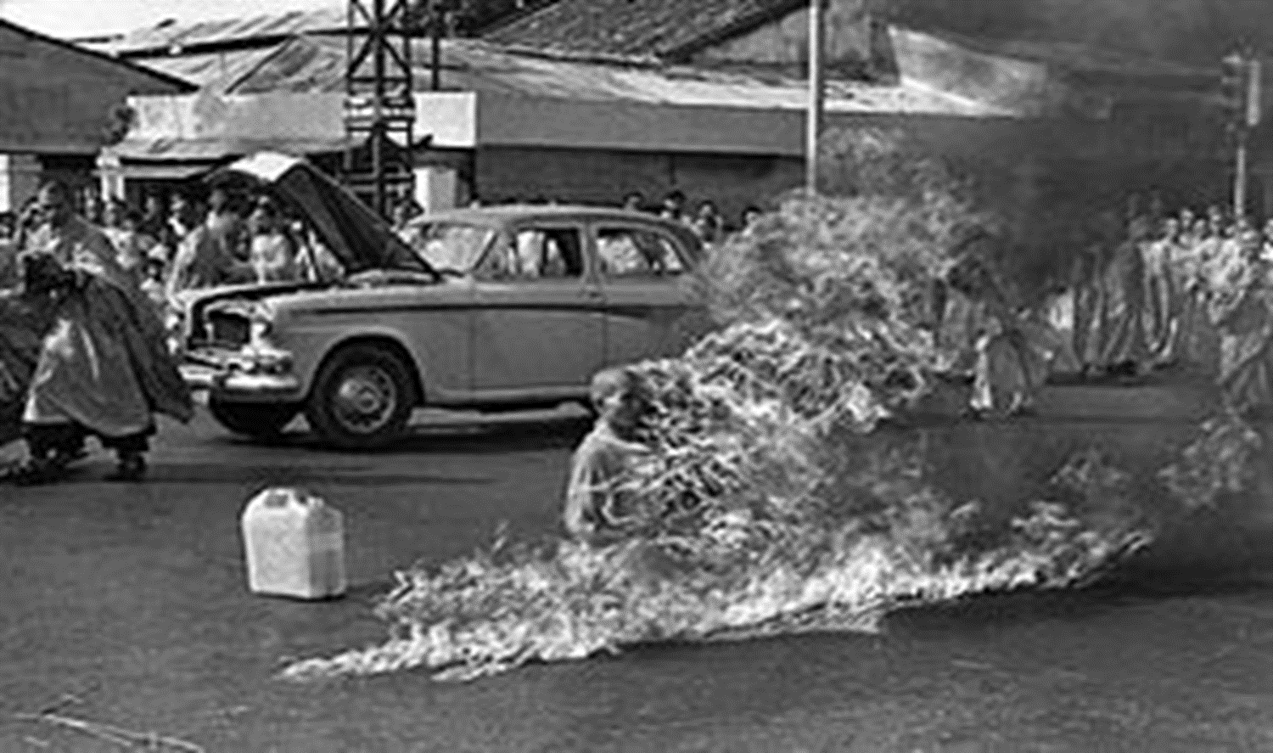
Diem is assassinated
Military coup seized power in south Vietnam on November 1st, 1963
Diem is assassinated
South Vietnam becomes even more unstable

Slide 6
Gulf of Tonkin
August 2nd, 1964: President johnson announced that north Vietnamese torpedo boats had fired on two American destroyers in the gulf of tonkin
Ordered American aircraft to attack north Vietnamese ships and naval facilities
Johnson didn’t reveal that American warships had been helping the south Vietnamese conducting electronic spying and commando raids against north vietnam

Slide 7
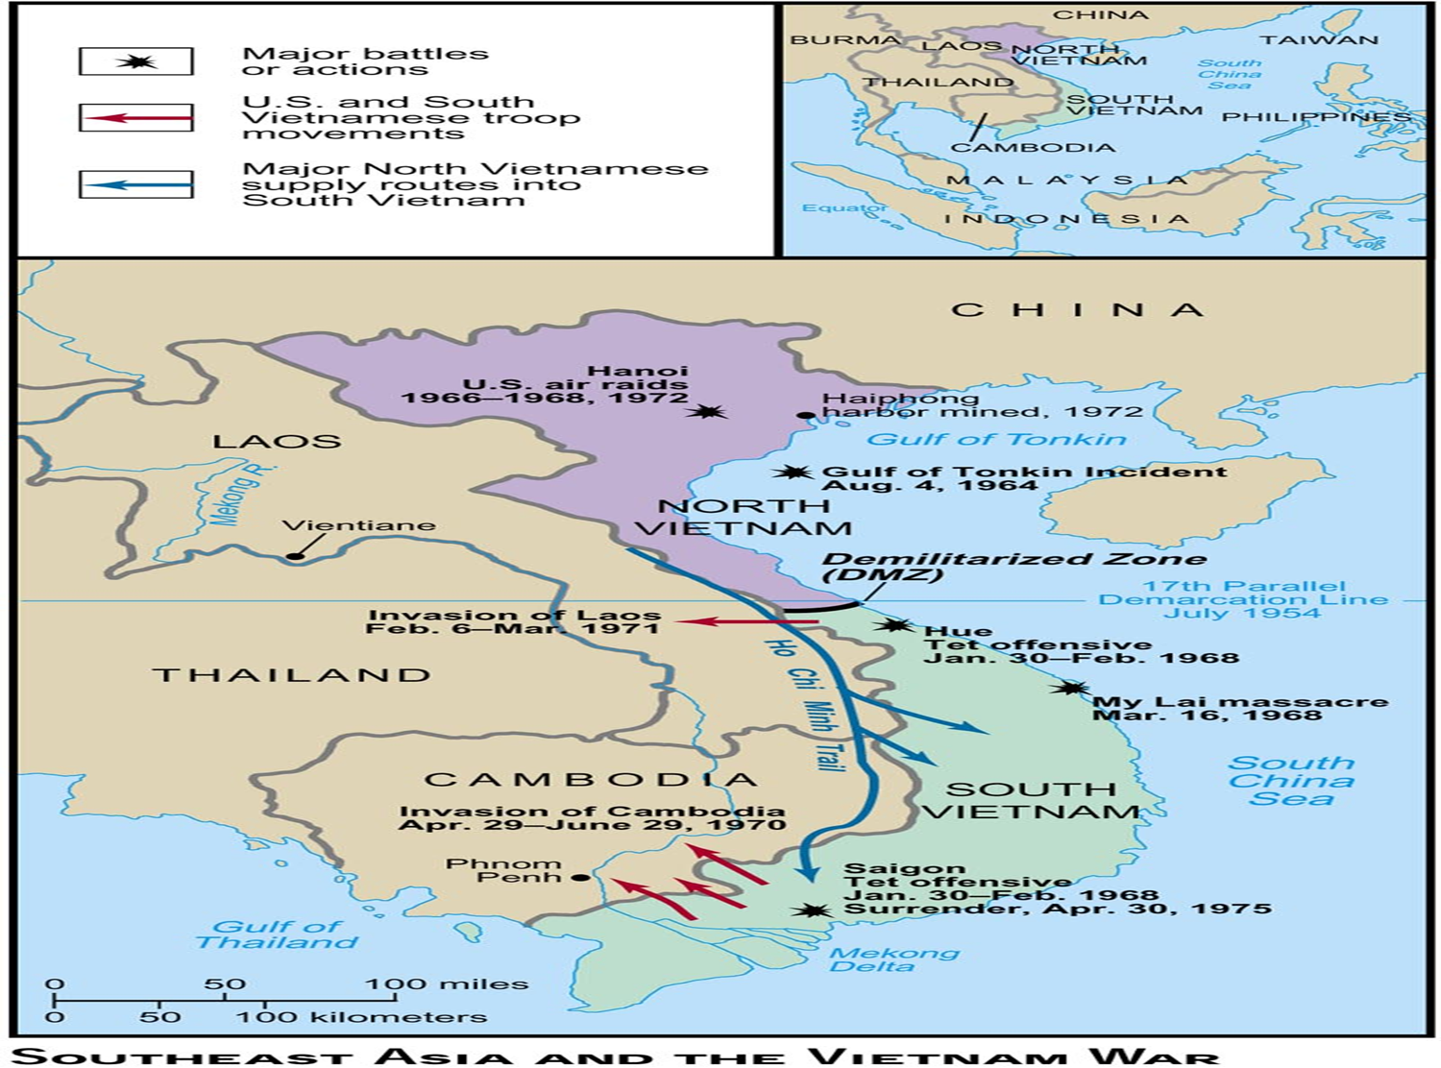

Slide 8
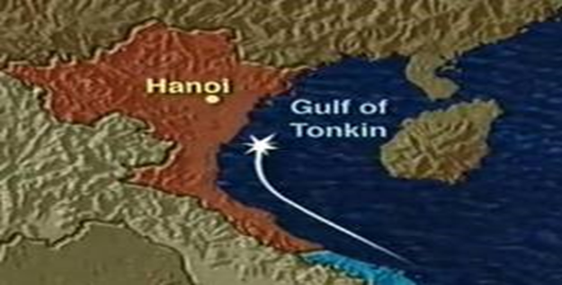
Gulf of tonkin resolution
Gives lbj a “blank Check” for the war in Vietnam
Authorized the president to “take all necessary measures to repel any armed attack against the forces of the united states and to prevent further aggression”
Congress had in effect handed over its war powers to the president

Slide 9
Operation rolling thunder
Between 1965 and 67, us dropped more tonnage of bombs on Vietnam than the allies dropped on Europe in all of wwii
Johnson authorized airstrikes on north Vietnam and his approval rating went up
Operation rolling thunder: 1965---sustained bombing campaign
March of 65: Johnson ordered the first combat troops into Vietnam
First official battle occurs at ia drang river valley
https://www.youtube.com/watch?v=fuaSi-H0oGY

Slide 10
By 1965, more than 180,000 combat troops were fighting in Vietnam
Number doubles in 1966
The Vietcong frustrated American troops by blending in the with the general population in the cities and countryside then quickly vanishing
Napalm and agent orange were used to root them out

Slide 11
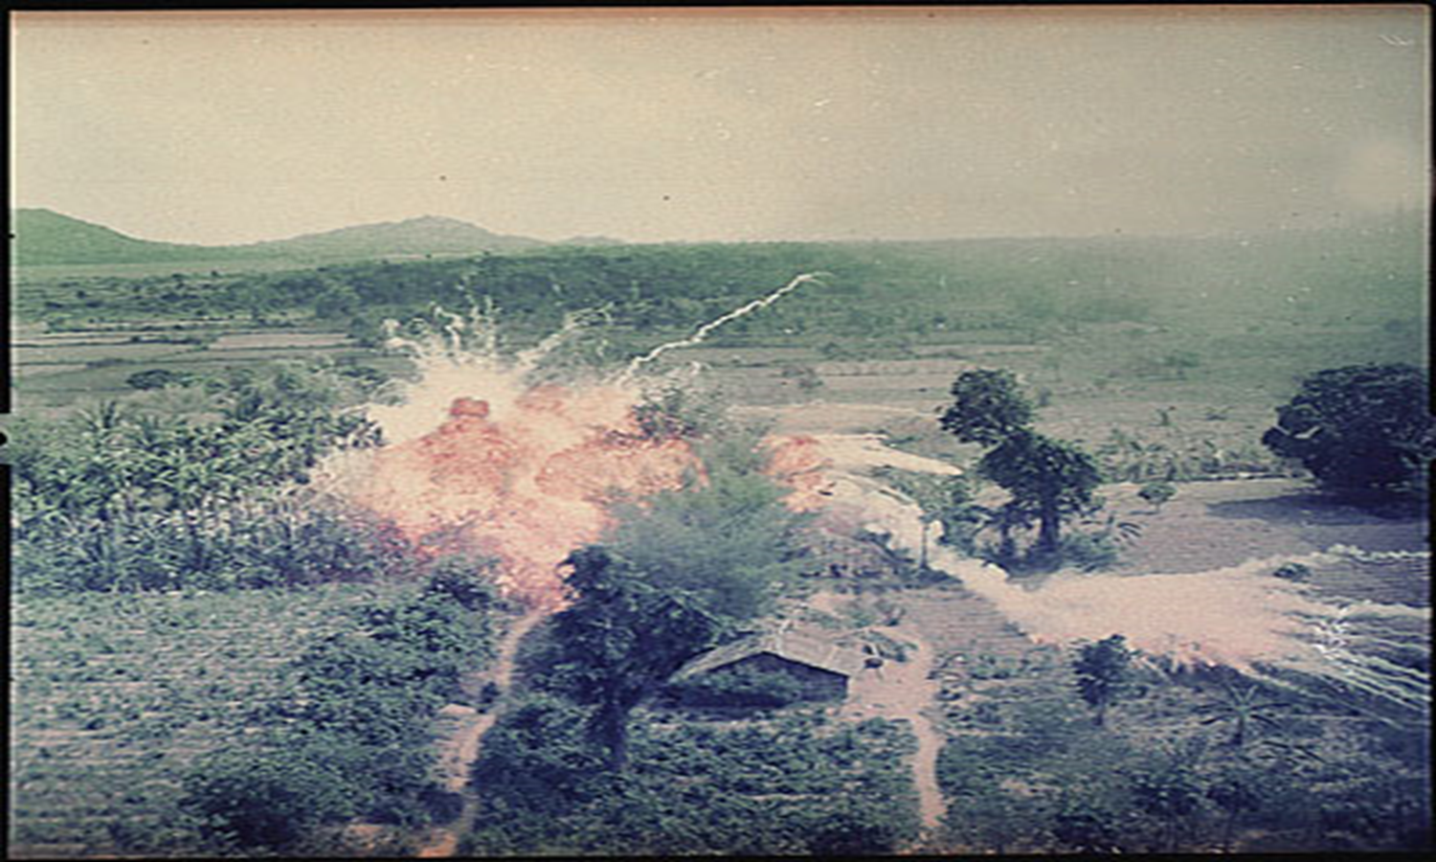
napalm

Slide 12
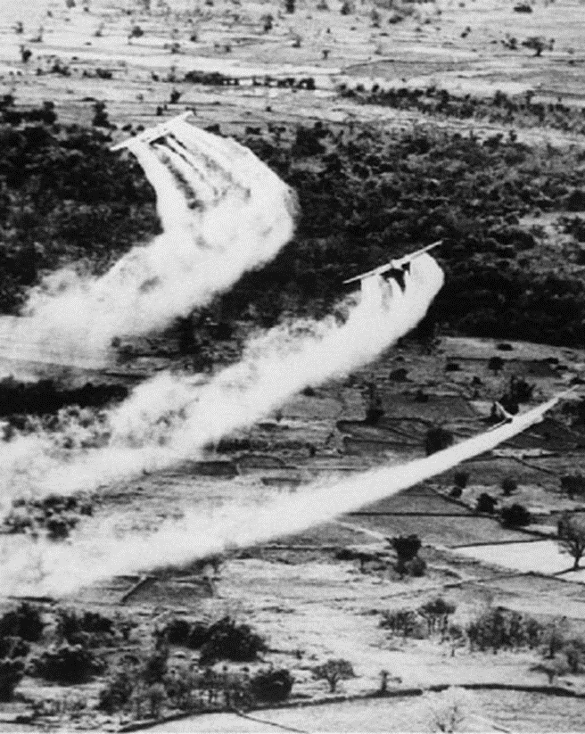
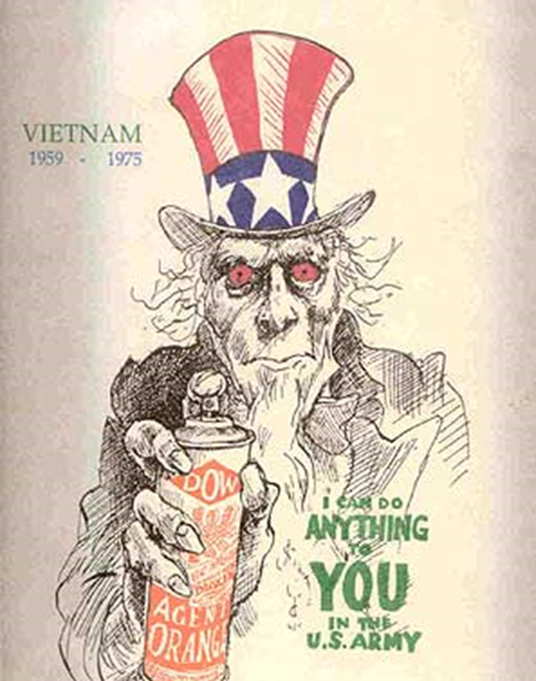
Agent orange

Slide 13
Estimated 20 million gallons of agent orange were deployed in south Vietnam
Birth defect
Spin bifida
Cancers
Skin disorders
The north Vietnamese army (NVA) supplied the Vietcong with arms, supplies, and advisers using the ho chi minh trail
Network of jungle paths that wound through Cambodia and laos

Slide 14
Johnson was forced to place limits on the war, making it nearly impossible to win. This was out of fear of full scale invasion of the north would provoke china into the war
By the end of 1966, more than 6,700 American soldiers had been killed

Slide 15
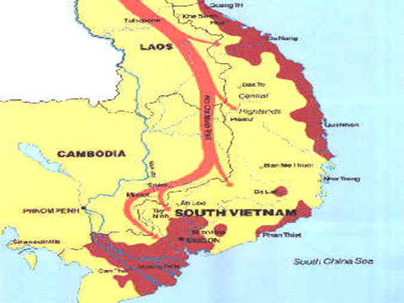

Slide 16
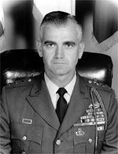
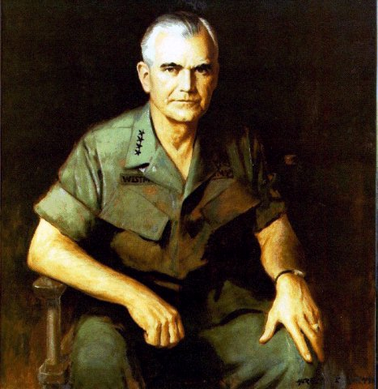
General William Westmoreland
American Commander in South Vietnam

Slide 17
Vietnam was the first “television” war
Credibility gap: It was hard for the American public to believe what the johnson administration was reporting

Slide 18
Antiwar movement
many opposed the military draft
early on: college deferment which caused much of the combat to fought by lower income population
Disproportion of African American troops in the early years of the war

Slide 19
Students for a Democratic Society (SDS)
Organized a march on Washington in 1965
Many draftees argued that if they were old enough to fight, they were old enough to vote
26th Amendment: Gives all citizens age 18 and older the right to vote in all state and federal elections (1971 ratified)

Slide 20
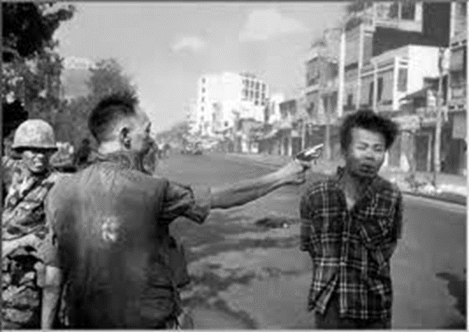
Doves: those opposed to war
Hawks: Those who supported the war
General loan shooting enemy suspect

Slide 21
The Tet Offensive
January 30th, 1968
The Vietnamese New Year
North Vietnamese launched a surprise attack
After a month of fighting, the American and South Vietnamese Troops repelled the enemy troops
Westmoreland requested an additional 206,000 troops on top of the 500,000 already in Vietnam
Although Tet was a defeat militarily for the North, it won politically. American at home saw that the U.S. could not win this war
Johnson decided not to run for president in the election of 1968

Slide 22
The War Winds Down
Nixon is elected president in 1968
Employs a strategy known as Vietnamization: Gradual withdrawal of U.S. troops while South Vietnam assume more of the fighting
My Lai Massacre:
Spring of 1968: Lt. William Calley had massacred possibly more than 200 unarmed South Vietnamese civilians in the hamlet of My Lai
Victims were old men, women, and children
Calley went to prison for his role in the killings, but sentence was eventually pardoned by Nixon
April of 1970: Nixon announced that American troops had invaded Cambodia

Slide 23
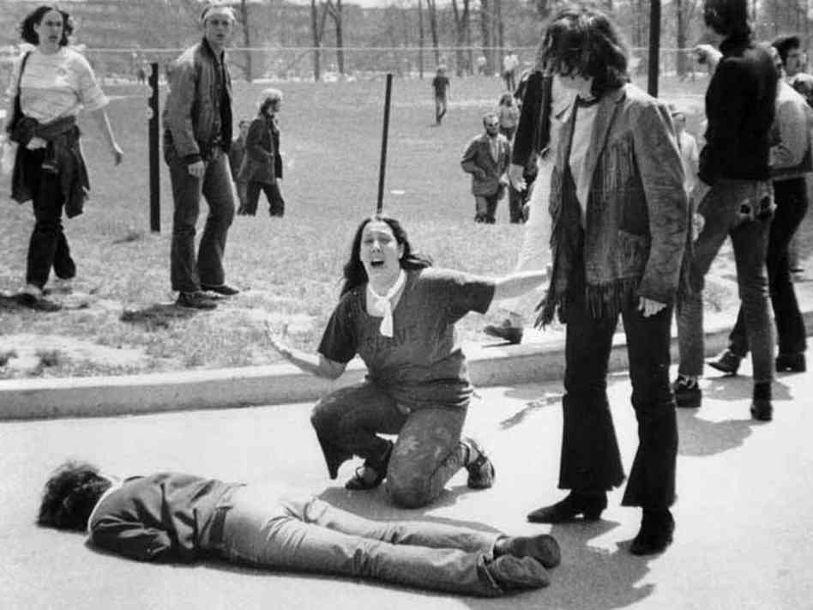
Kent State
May 4, 1970
Ohio National Guard fired on demonstrators without an order to do so
Four students were killed and nine other wounded

Slide 24
Pentagon papers
Defense department information leaked: revealed that the government was not being completely honest with the American people

Slide 25
The us pulls out of vietnam
By 1971, 2/3rds of americans disapproved of the war
January of 1973, the north and south signed a peace agreement
Us started to pull out its troops
March 1975: The north launched a full scale invasion of the south. By the end of the year, Saigon fell and was renamed ho chi minh city
War powers act: Requires the President to inform Congress of any commitment of troops abroad within 48 hours and to withdraw them in 60 to 90 days unless Congress explicitly approved the troop commitment

Slide 26
Cost of the war
58, 129 American killed
300,000 were wounded in action
75,000 were disabled
2.7 million fought in Vietnam
The average age was 19
Approximately 1,300 remain missing in action

Slide 27
Vietnamese cost of war
1.1 million north Vietnamese and Vietcong were killed
Over 2 million north and south Vietnamese citizens were killed

